Slide 1

COVID-19 Vaccination Progress
This Photo by Unknown Author is licensed under CC BY
Measured by County in California from 2020 to 2021

Slide 2
Contents
Introduction - Jennifer
Process - Chithra
Data Review
Question 1 - Jessica
Question 2 - Abdellah
Question 3 - Eric
Conclusion Jennifer
Closing - Chithra

Slide 3
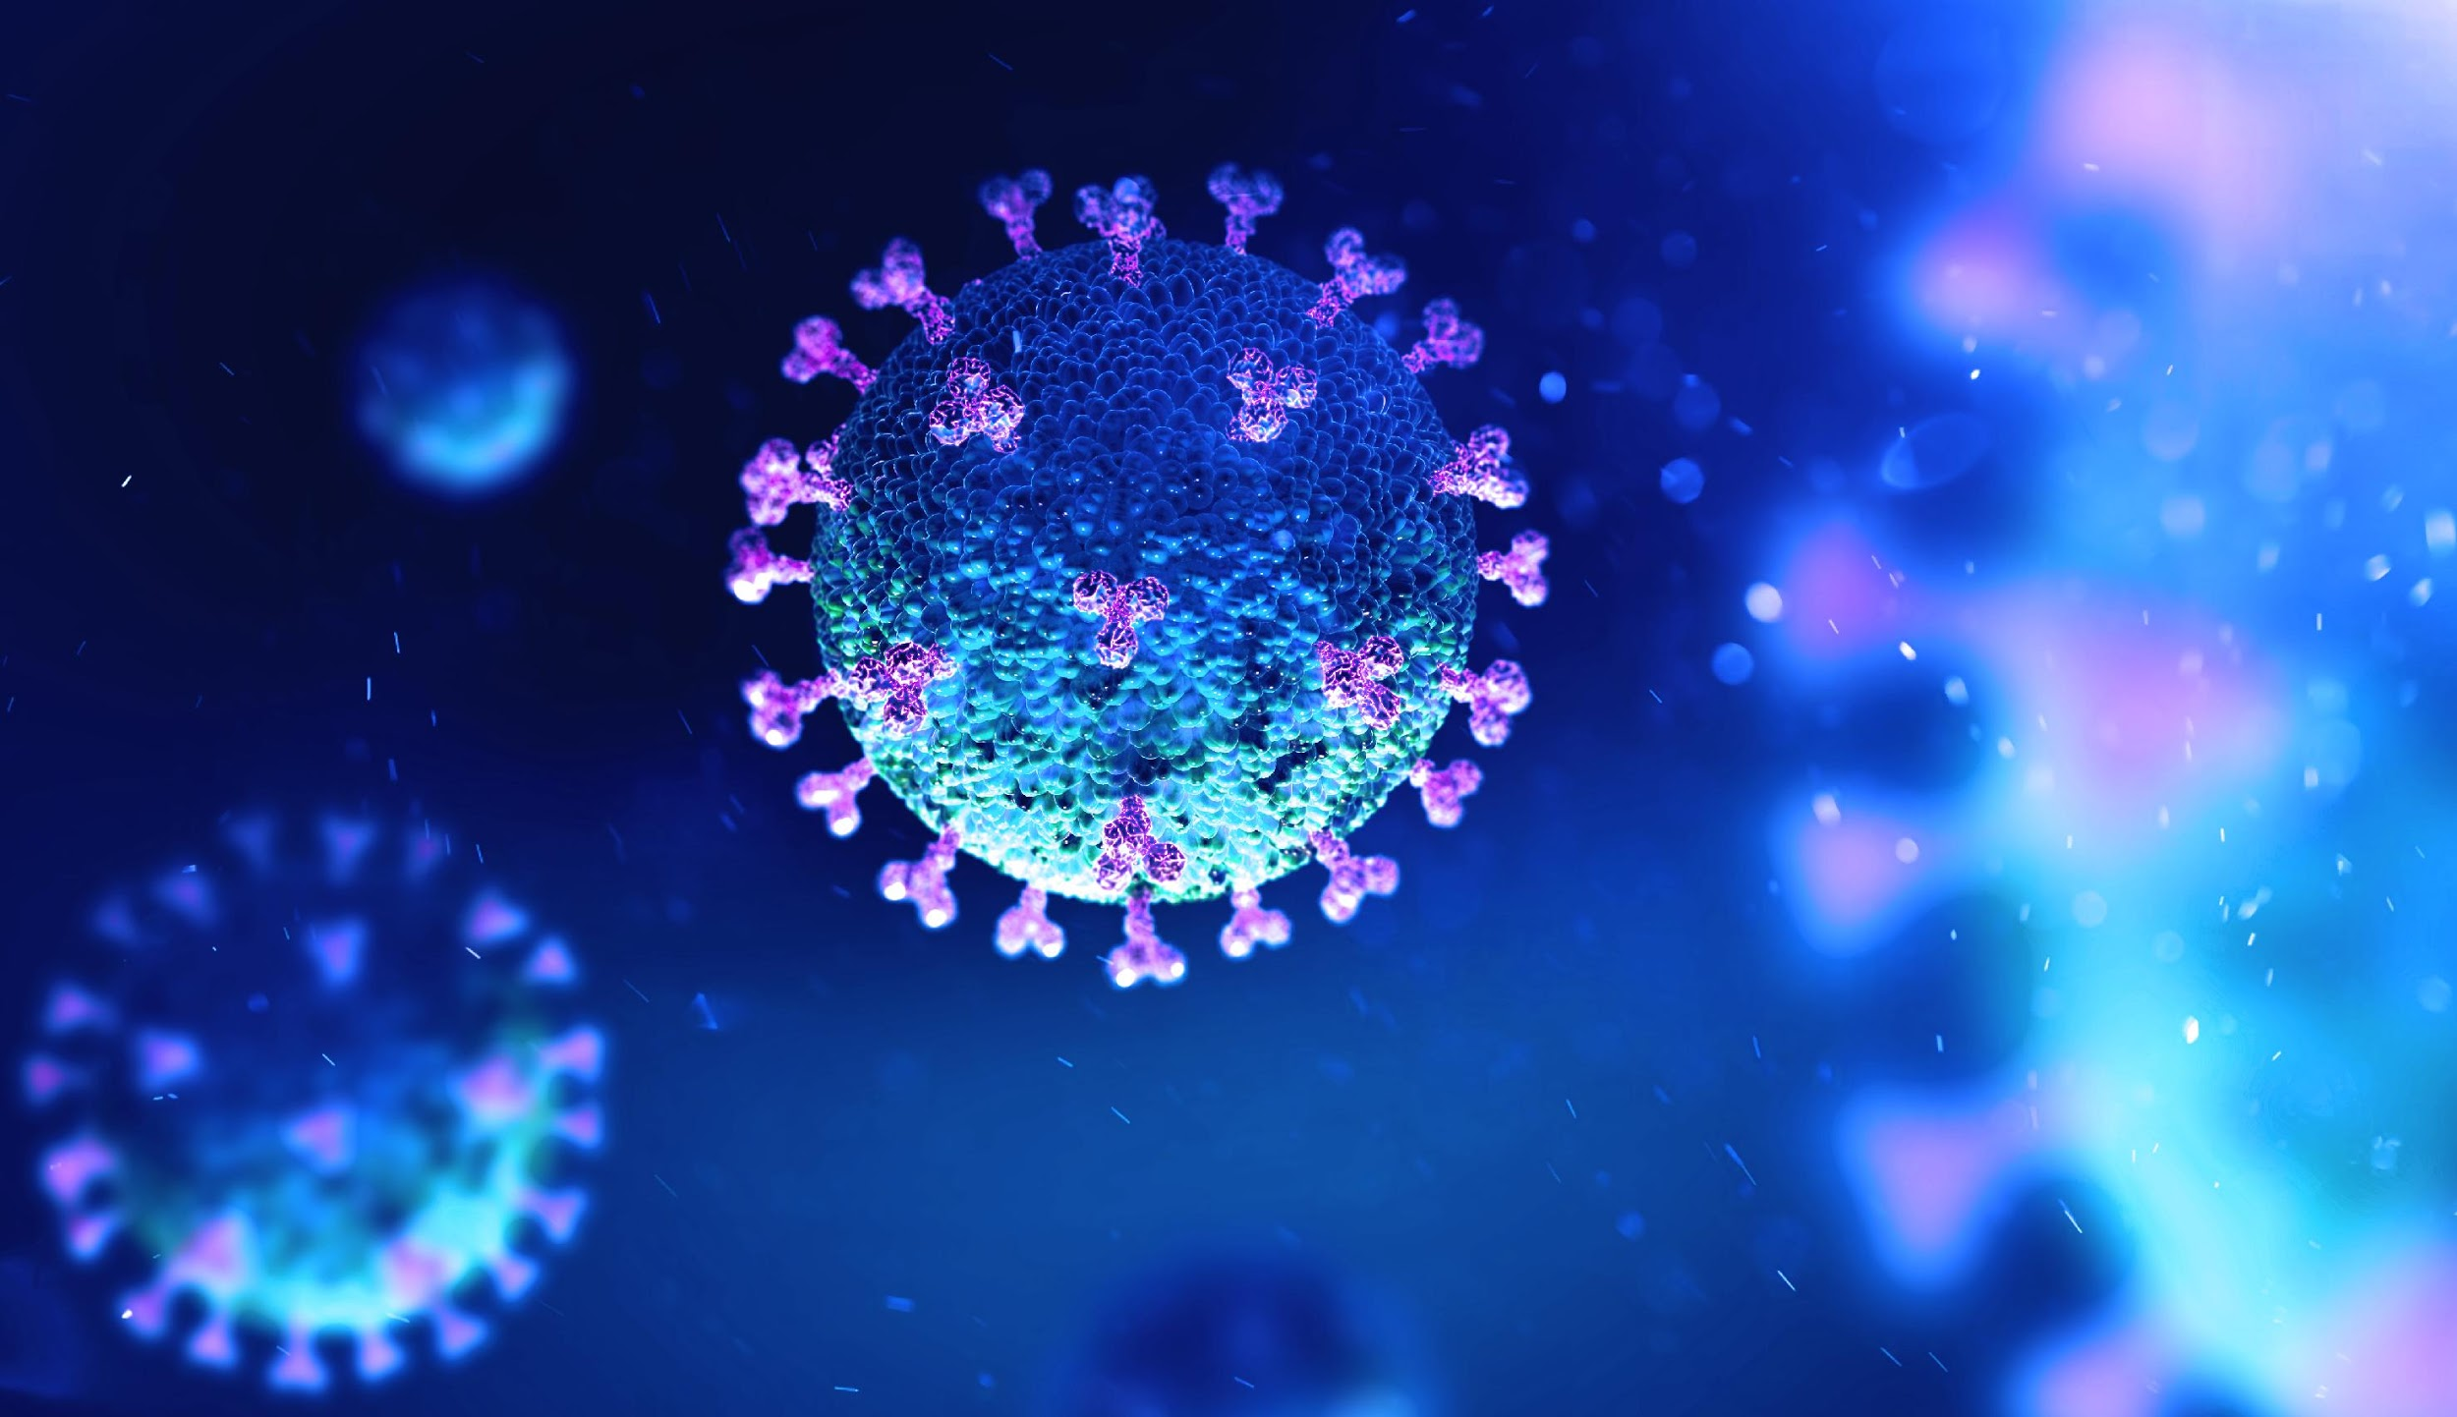
Introduction Proposal Hypothesis
This Photo by Unknown Author is licensed under CC BY-ND
Notes:
Proposal:
The kind of data we will use is csv files found online, no APIs. We will be using information found on the COVID-19 World Vaccination Progress, as well as demographics to help us with our analysis. We may need to focus on the progress in the US, based on the datasets available.
Possible data sources:
By race in the US [Link]
Vaccine Hesitancy for COVID-19: County and local estimates [Link]
COVID cases and deaths [Link]
Vaccinations Progress [Link]

Slide 4

Process
High level topic review
Data selection
Narrow and identify topics
Data Review:
CSV Data pull from various locations
Clean data, such as duplicate counties
Identify anomalies in the demographic data
Develop data frames and appropriate graphs to answer questions
This Photo by Unknown Author is licensed under CC BY

Slide 5
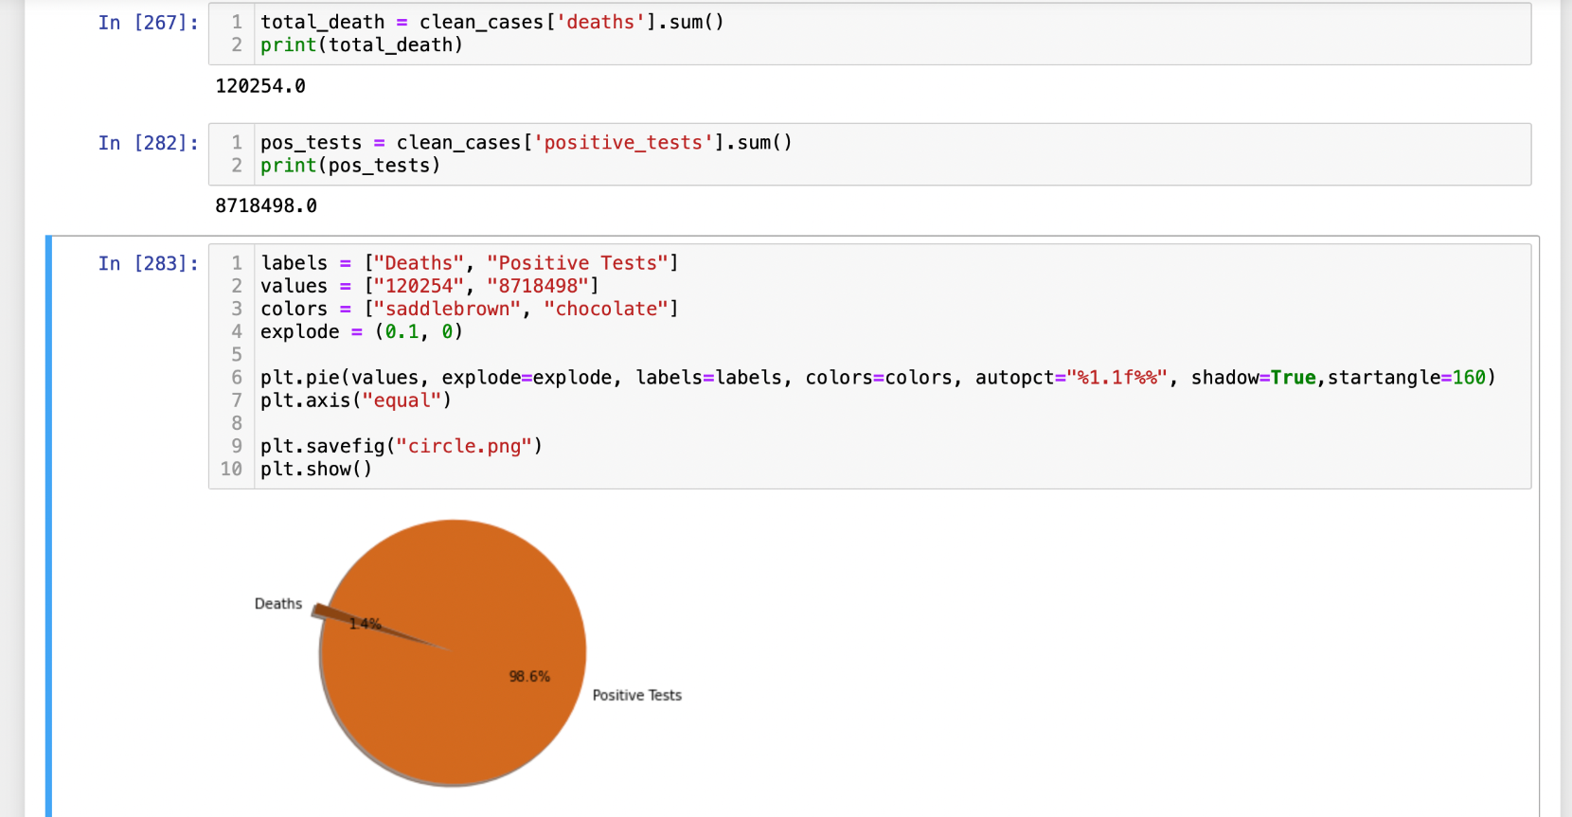
What is the correlation between COVID cases and COVID related deaths?
Notes:
The chart shows the relationship between COVID cases and COVID related deaths by county in California.
Process
The horizontal (x-axis) shows the percentage of reported cases by county. (cases - total reported tests)
The vertical (y-axis) shows the percentage of reported deaths by county. (deaths - total reported cases)
Simply looking at the chart, it shows as --- increases, ---- also increases.
Positive Correlation: Both variables move in the same direction. In other words, as one variable increases, the other variable also increases.
Reflective of the months when the spread of Covid was higher/high number of cases
Each dot on the scatter plot represents one county from the data. Counties with higher
Outliers are further out.

Slide 6
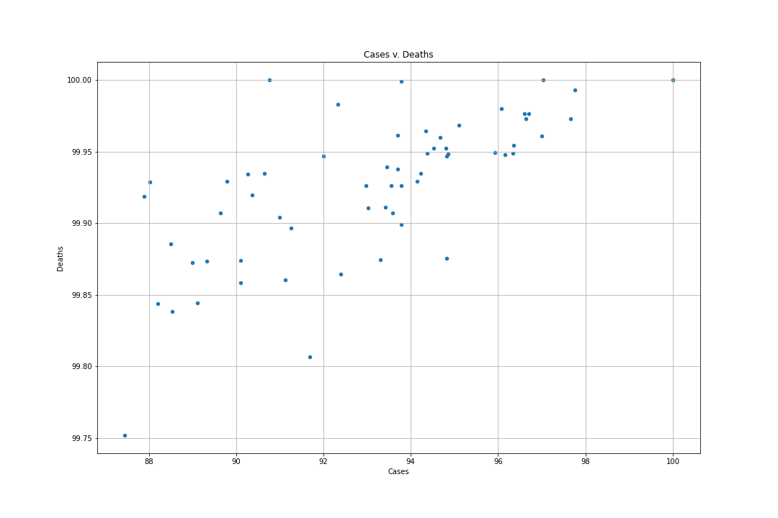
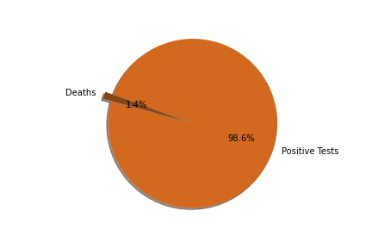
What is the correlation between COVID cases and COVID related deaths?
Process for creating chart
Positive correlation between cases and deaths
Notes:
The chart shows the relationship between COVID cases and COVID related deaths by county in California.
Process
The horizontal (x-axis) shows the percentage of reported cases by county. (cases - total reported tests)
The vertical (y-axis) shows the percentage of reported deaths by county. (deaths - total reported cases)
Simply looking at the chart, it shows as --- increases, ---- also increases.
Positive Correlation: Both variables move in the same direction. In other words, as one variable increases, the other variable also increases.
Reflective of the months when the spread of Covid was higher/high number of cases
Each dot on the scatter plot represents one county from the data. Counties with higher
Outliers are further out.

Slide 7
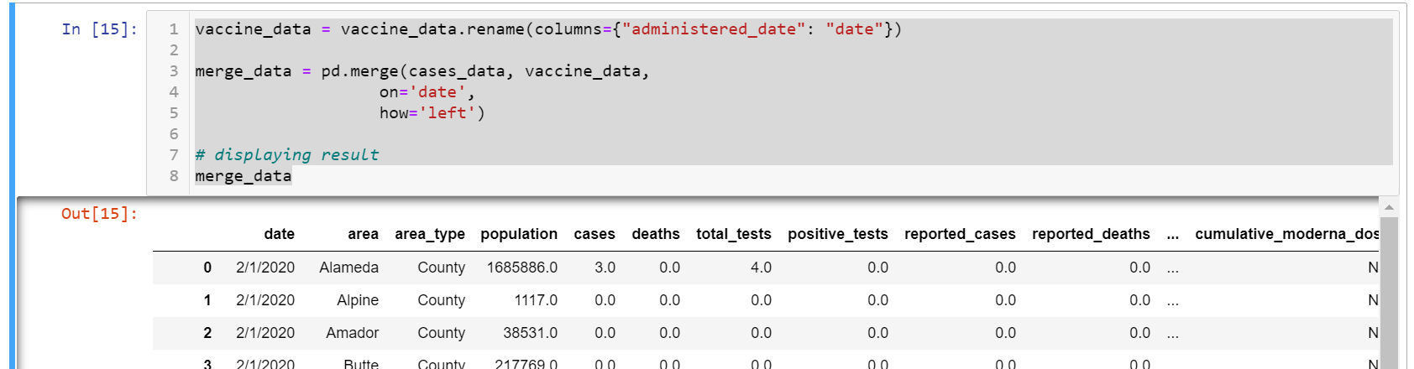
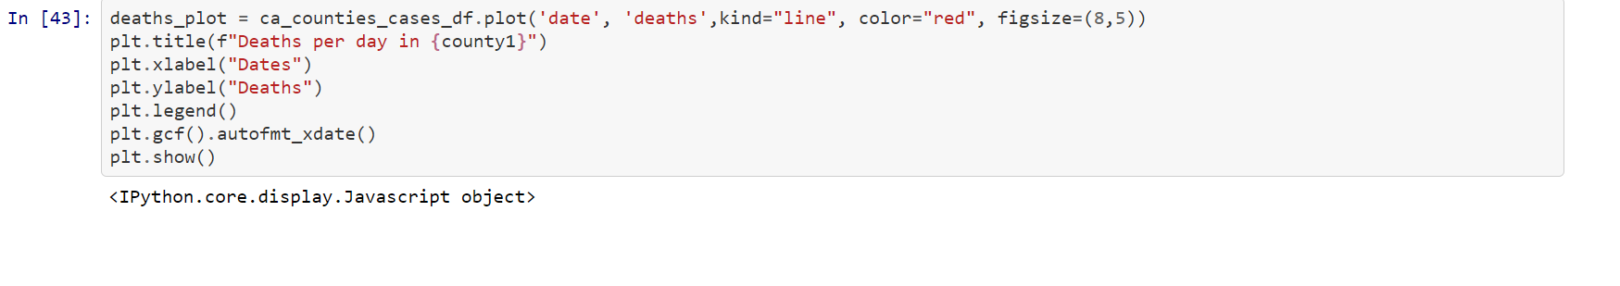
How does vaccination rate affect the case / death rate?
Notes:
will be 3 charts

Slide 8
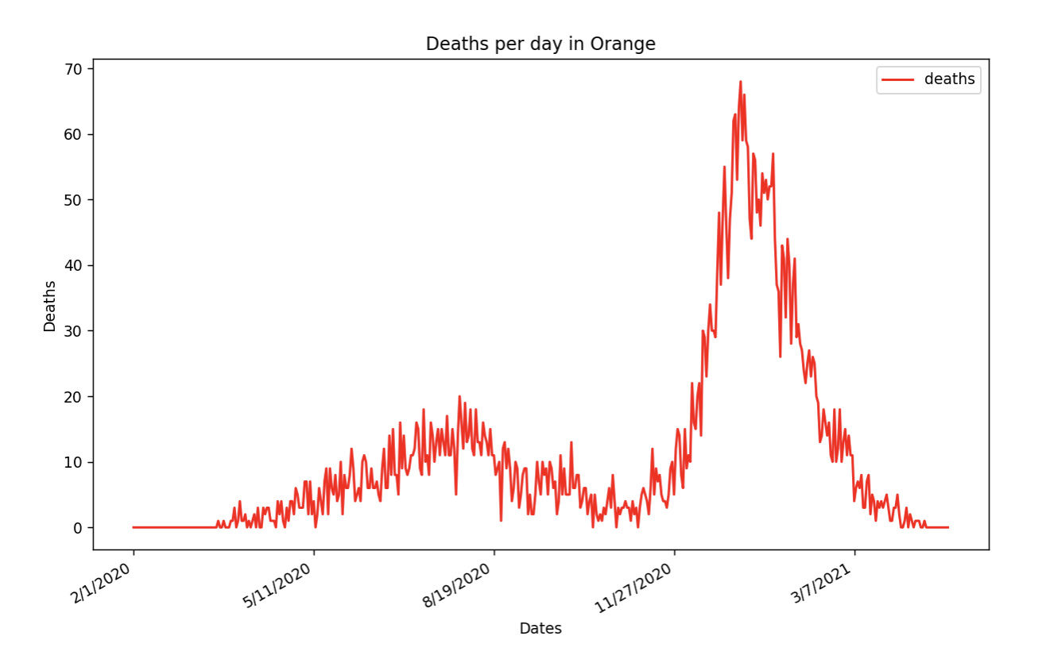
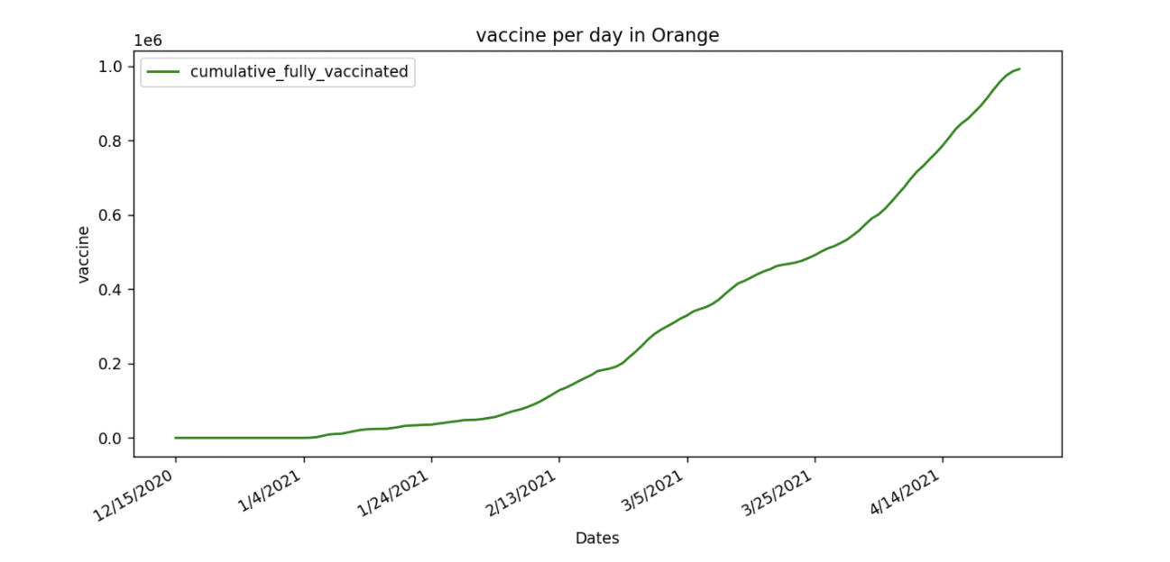
How does vaccination rate affect the case / death rate?
Detail of Vaccine vs Death Rate per day in 2021:
The initial rate of death did not show an initial impact from the vaccinations
The rate of vaccination increase is in direct correlation to the decline in death
Notes:
will be 3 charts

Slide 9
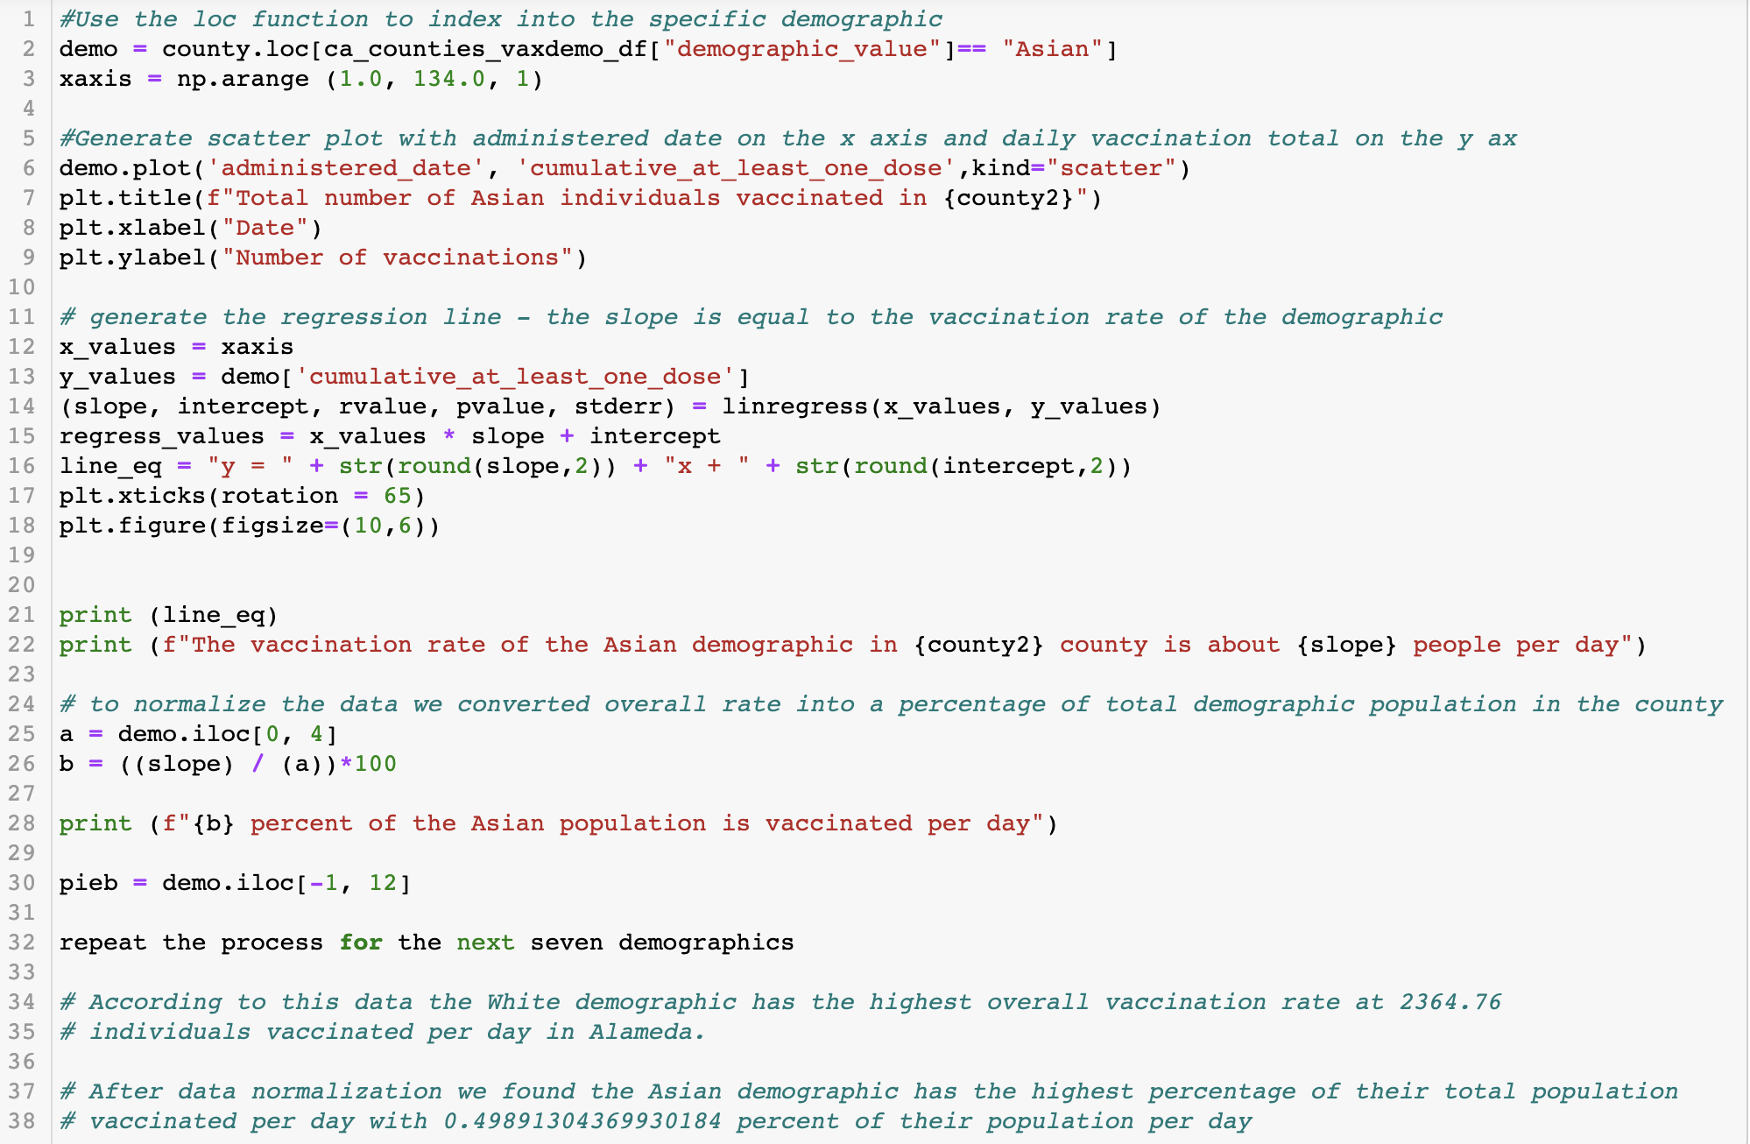
Which demographics have the highest vaccination rate in California?
Notes:
8 demographics - 8 charts, and one pie chart

Slide 10
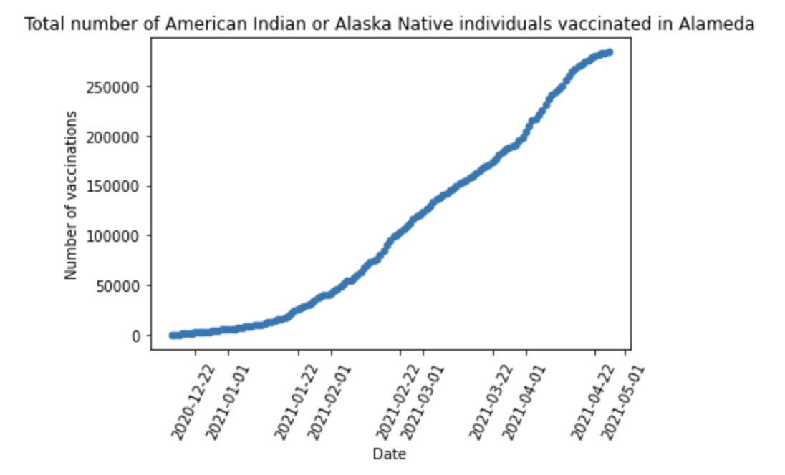
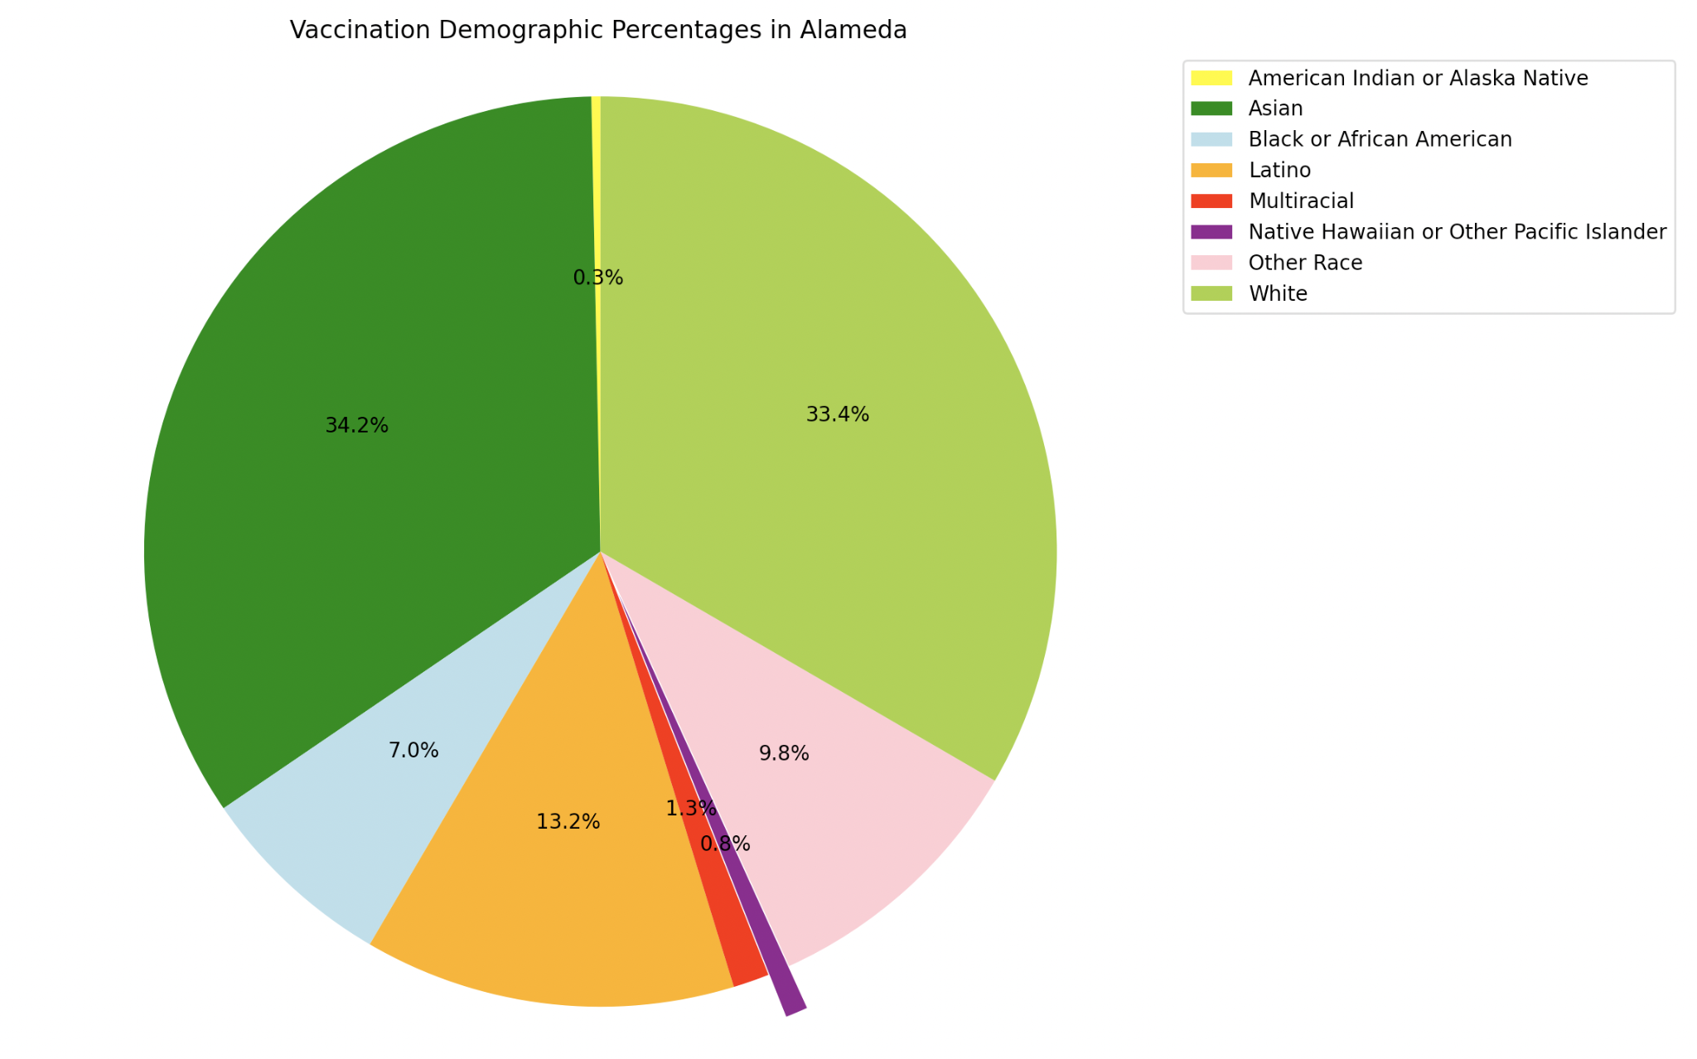
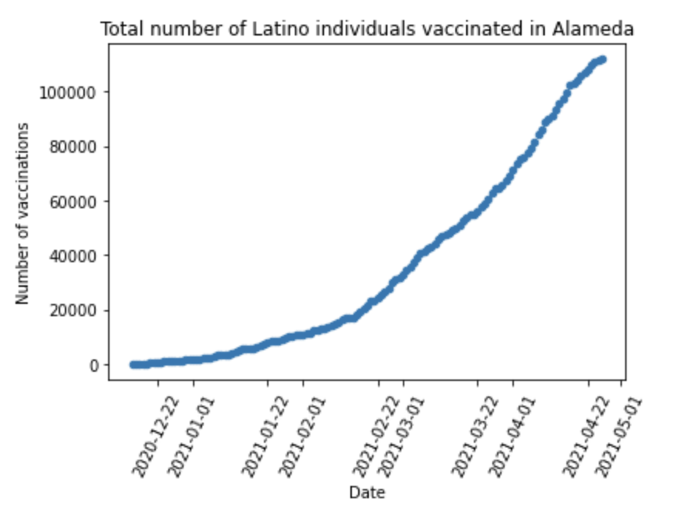
Which demographics have the highest vaccination rate in California?
As of April 2021:
American Indian or Alaskan Native vaccinations have scaled past 250K
Latino vaccinations have scaled past 1million
Notes:
8 demographics - 8 charts, and one pie chart

Slide 11
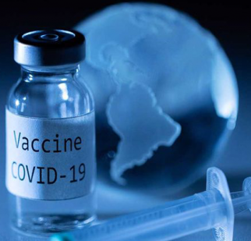
Conclusion
There is a strong correlation between COVID cases and COVID related deaths
Vaccination rates have a direct impact to the rate of deaths
There is a serious disparity in vaccination rates in some demographics
Recommendation: Improving the rate of vaccinations across all demographics will have a positive impact on the death rate
This Photo by Unknown Author is licensed under CC BY

Slide 12

Closing

